Slide 1
制定简单决策
Chapter 16

Slide 2
内容大纲
期望效用最大化
效用函数
金钱
多属性效用函数
决策网络
信息的价值

Slide 3

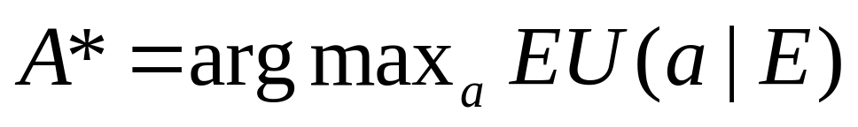
期望效用最大化
效用函数U：对状态的好坏用一个实函数来表示
最大期望效用原则(Principle of Maximum Expected Utility):

Slide 4
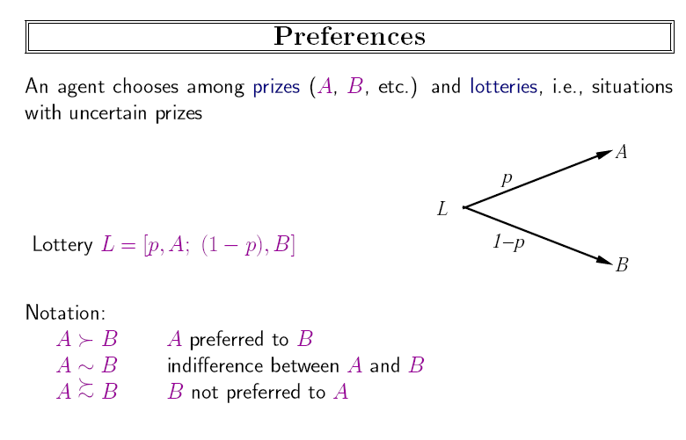

Slide 5
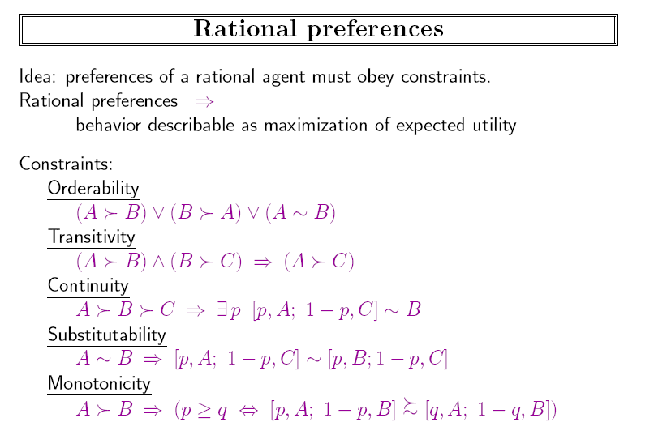
also called axioms of utility theory

Slide 6
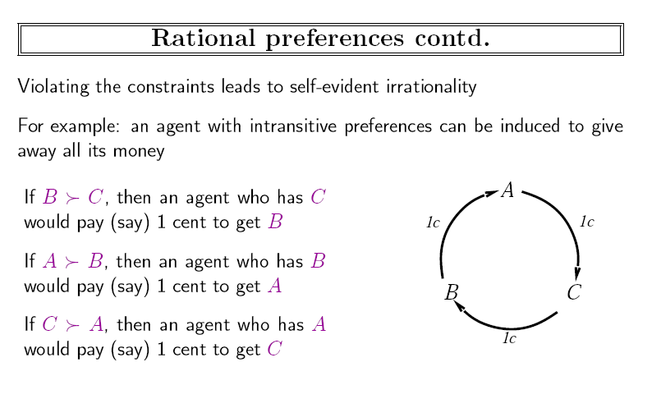

Slide 7
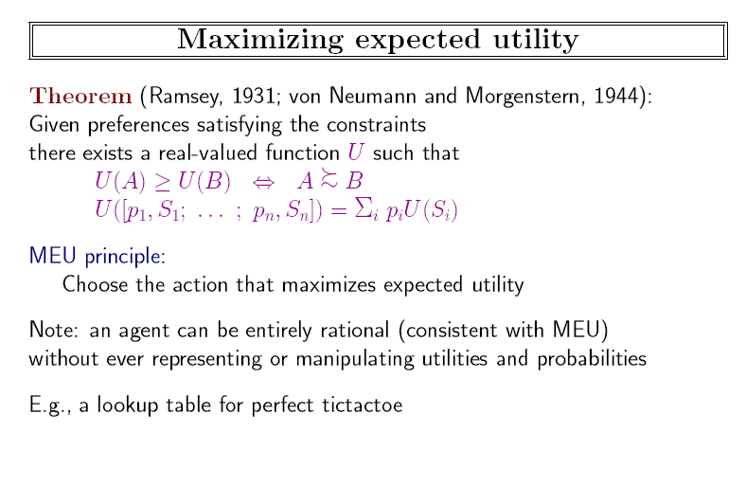

Slide 8
金钱
你在电视竞赛中赢了100万，假设主持人在让你做一个题目，赢了得300万，输了归还100万，你答对的可能性是50%。你是答还是不答？
Expected Monetary Value=$1.5m
EU(Accept)=0.5U(S_{k})+0.5U(S_{k+3000000})
EU(Decline)=U(S_{k+1000000})
S_{n}表示拥有金钱n的状态

Slide 9
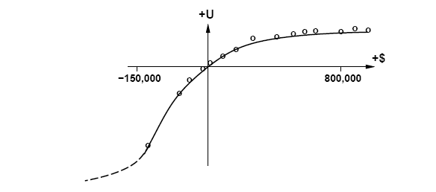
Utility和Money不是一回事
U(S_{k+n}）= -263 + 22 log (n+150000)
(k：已有的钱数,n：获得的钱数？)
（公式和k无关？？）

Slide 10

为什么要保险
不喜欢风险，所以才有保险业。
保费（insurance premium）：the difference between the EMV of a lottery and its certainty equivalent

Slide 11

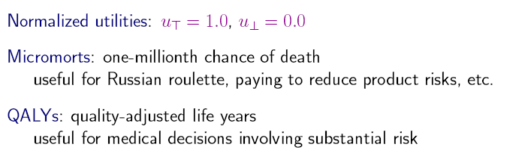
Utility的度量：生命无价？
天地不仁，以万物为刍狗
圣人不仁，以百姓为刍狗。

Slide 12
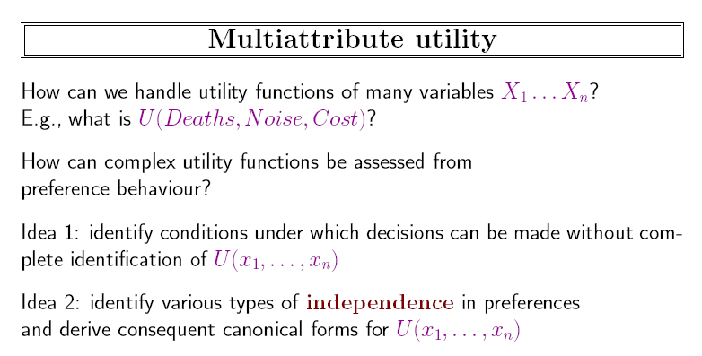

Slide 13
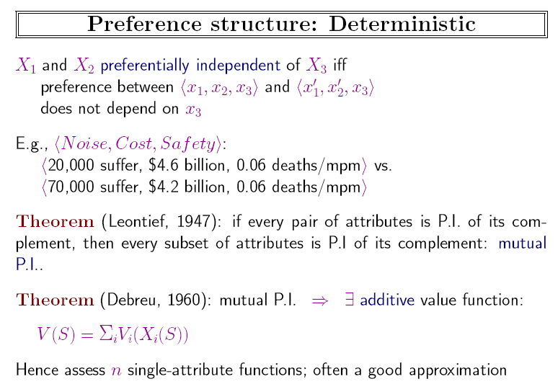

Slide 14
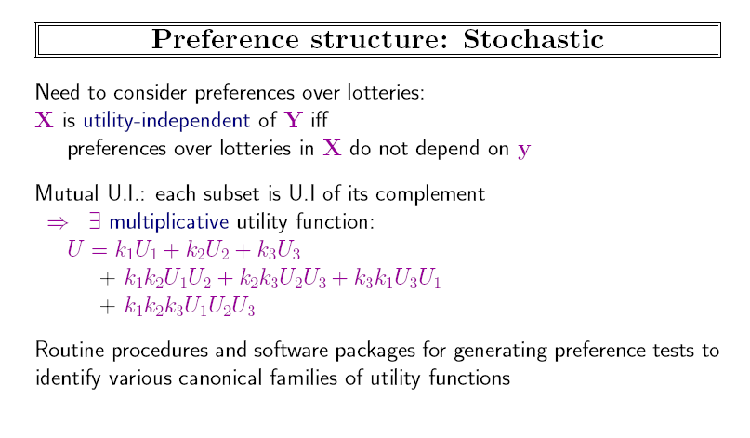

Slide 15
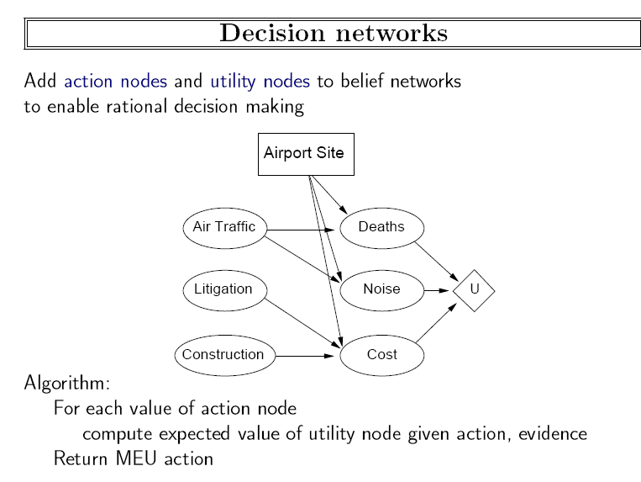

Slide 16
Value of Information
Agent often has to gather information before making decisions
一块油田，价值C，分成n块，每块均价C/n，但是只有一小块有油。
地震学家说可以检测某块是否含油。钻井公司可以为检测报告付多少钱呢？
  报告说该块含油，买！赚C-C/n
  无油，则买另一块，发现油概率为C/(n-1), 预期赚C/(n-1) -C/n
  综合两种情况，预期赚(1/n)(C-C/n)+((n-1)/n)(C/(n-1) -C/n)=C/n
  信息价值不超过C/n

Slide 17
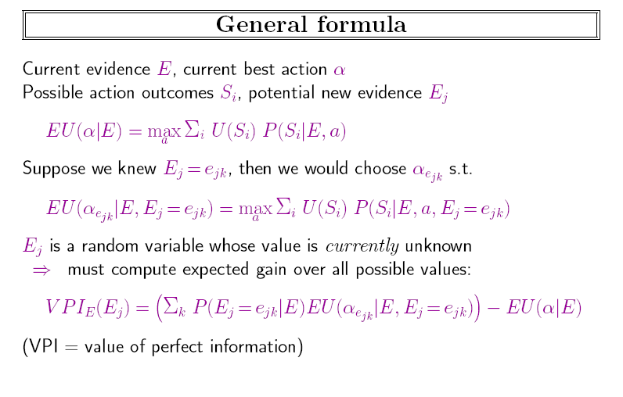

Slide 18
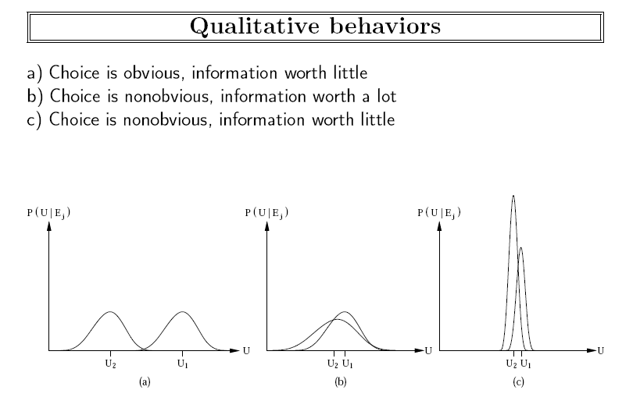

Slide 19
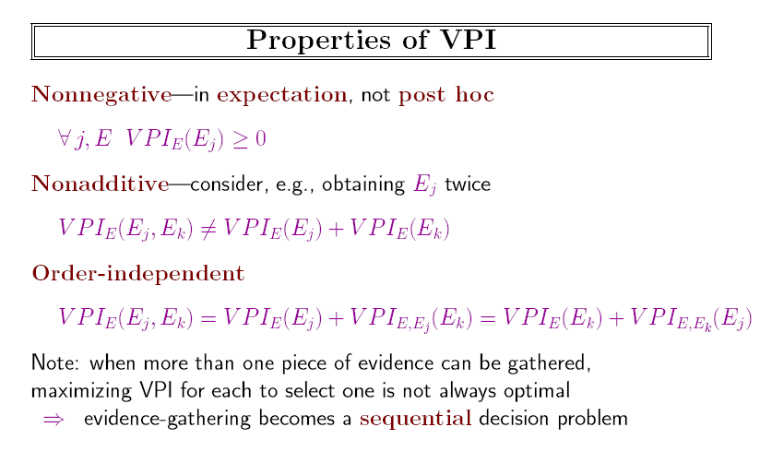
Myopic (近视) information-gathering agent

Slide 20
作业
16.2 Tickets to lotter cost $1. There are two possible prizes: a $10 payoff with probability 1/50, and a $1,000,000 payoff with probability 1/2,000,000. What is the expected monetary value of a lottery ticket? When (if ever) is it rational to buy a ticket? Be precise—show an equation involving utilities. You may assume that U($10)=10xU($1),but you may not make any assumptions about U($1,000,000). Sociological studies show that people with lower income buy a disproportionate number of lottery tickets. Do you think this is because they are worse decision makers or because they have a different utility function?

